Slide 1
Hackathon Presentation
Anti-DDoS SDN Application
杨帅、赖香武、裴超

Slide 2
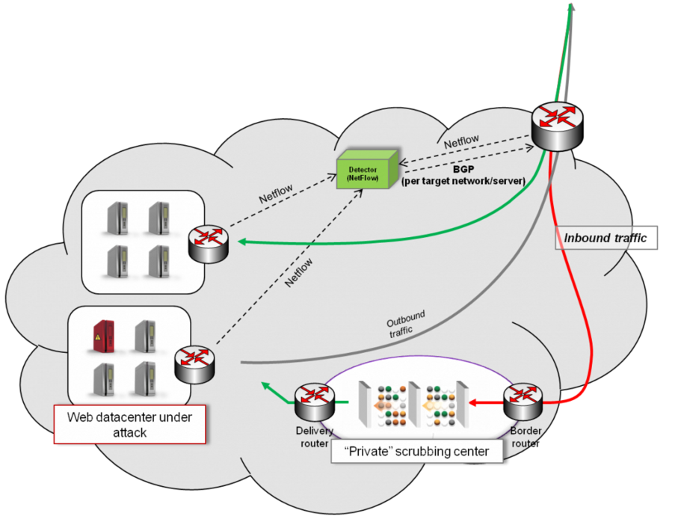
Traditional solutions
Traditionally, Anti-DDoS solutions use Netflow for statistics collection and BGP to divert the infected traffic to a “scrubbing center” where the mitigation equipment cleans it up and then returns the valid traffic to the target servers.
As shown in the right figure, where red lines represented infested traffic, while green lines represent clean valid traffic:
https://wiki.opendaylight.org/view/Project_Proposals:Defense4All

Slide 3
Architecture
traffic
Controller
policy
after scrub
result
bad traffic
mirror
DDoS Scrub
Switch
IDS
DC

Slide 4
operations
Configure mirror port to IDS on openflow switch
Put flowtable policys to controller with external application
Divert traffic to DDoS
DDoS return traffic after scrub

Slide 5
Test
Simulate original traffic (20 packet, tcpreplay tools)
Configure and check mirror port result (wireshark)
Select infected traffic from original traffic (Simulate IDS)
External application draft policy to divert the infected traffic to DDoS Scrub and divert the return traffic from DDoS Scrub to DC
Check traffic direction

Slide 6
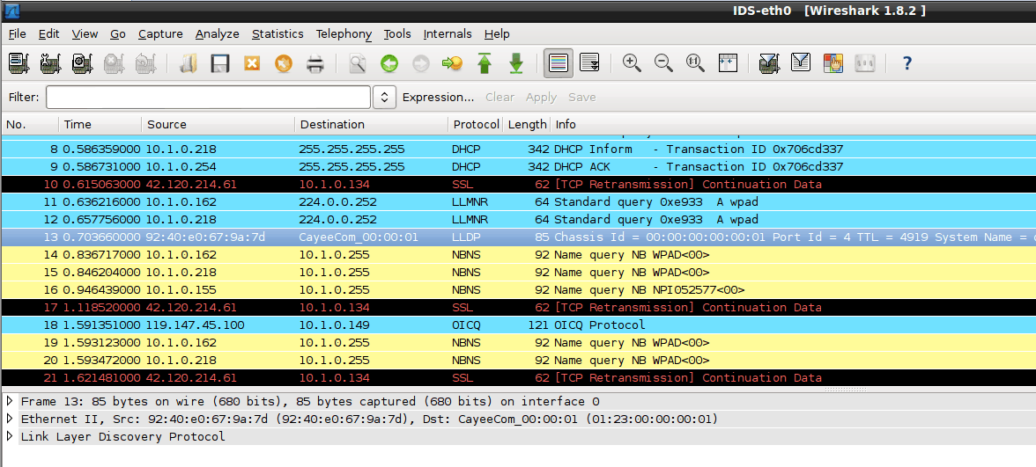
Original traffic in mirror port

Slide 7
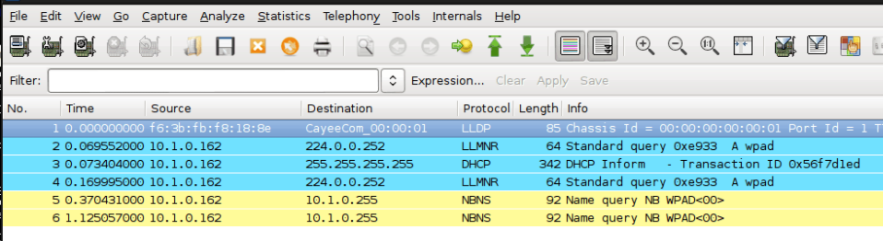
Divert to DDoS traffic

Slide 8
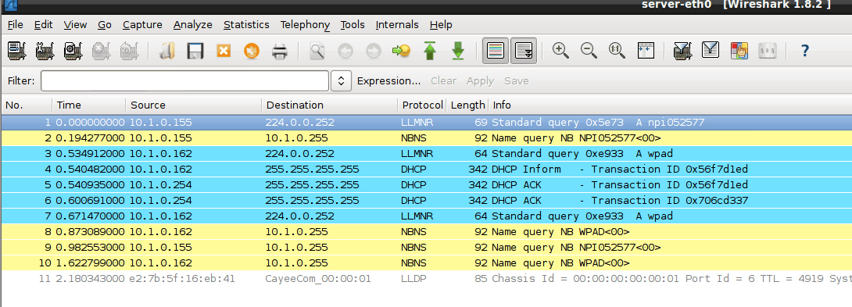
After scrub

Slide 9
Status
Proactive is finished (external application)
Function include: policy put, mirror transmit, infected traffic divide
Proactive to Reactive
Enhance policy manage
And more …
Future work

Slide 10
Thank you !

